Slide 1
STRATEŠKI OKVIR PROMOCIJE CJELOŽIVOTNOG UČENJA U REPUBLICI HRVATSKOJ 2017.-2021. STRATEGIC FRAMEWORK FOR PROMOTION OF LIFELONG LEARNING IN THE REPUBLIC OF CROATIA 2017-2021

Slide 2
Platonova špilja / Plato’s cave?

Slide 3
PURPOSE OF PROMOTION?
TO INFORM…..
TO REMIND…..
TO PERSUADE…..

Slide 4
What HAS BEEN ALREADY DONE…
Nine years of continuous learning promotion (since 2008) in the entire country: The lifelong learning week – organized by Agency for vocational education, training & adult education and partners from the entire country
Learning fairs, lifelong learning award MASLAČAK ZNANJA, celebrity endorsements, etc.
Skills Croatia/EuroSkills competition
EPALE project implementation
National qualification ESF project for andragogy professionals (in association with the Faculty of Humanities and Social Sciences Split)
Five international andragogy symposia
Etc.

Slide 5
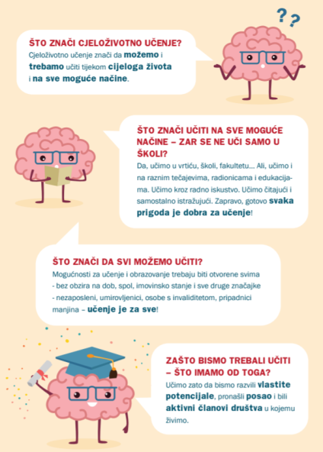
NINE YEARS OF CONTINUOUS LEARNING PROMOTION: Tjedan cjeloživotnog učenja (hrvatska) – the lifelong learning week (croatia) – THE 2017 EXAMPLE http://www.cjelozivotno-ucenje.hr/organiziranje-tjedna-u-hrvatskoj/

Slide 6
NINE YEARS OF CONTINUOUS LEARNING PROMOTION: Tjedan cjeloživotnog učenja (hrvatska) – the lifelong learning week (croatia) – THE 2017 EXAMPLE http://www.cjelozivotno-ucenje.hr/organiziranje-tjedna-u-hrvatskoj/

Slide 7
NINE YEARS OF CONTINUOUS LEARNING PROMOTION: Tjedan cjeloživotnog učenja (hrvatska) – the lifelong learning week (croatia) – THE 2017 EXAMPLE http://www.cjelozivotno-ucenje.hr/organiziranje-tjedna-u-hrvatskoj/

Slide 8
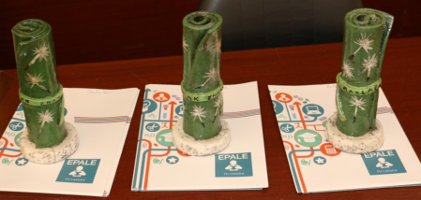
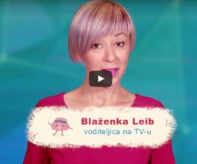
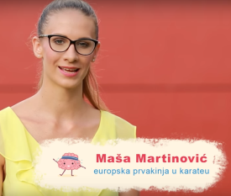
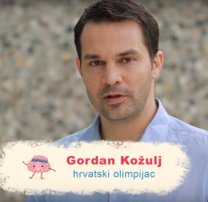

Slide 9
What we have done…
A working group has been established in October 2016, based on a public call to experts in the fields of public policies in education, adult education & entrepreneurship support, nonprofit & public marketing/management.
The group tasks:
establish the baseline ‘snapshot’ of the adult education in Croatia;
analyse relevant EU & national policy documents;
propose a methodology for promotion of adult education in Croatia, incorporating the existing examples of good practice;
develop an inclusive strategic framework for promotion of adult education.

Slide 10
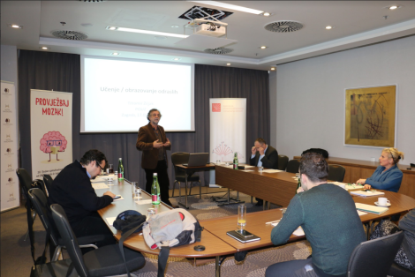
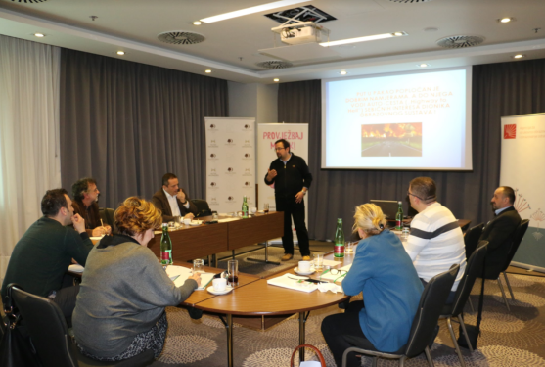

Slide 11
Our methodology
Individuals are responsible for their own learning: a strategic framework for lifelong learning promotion will be an enabling and supporting tool.
Adult education is the key area and theme in our approach to the lifelong learning promotion. Both learning for new vocational skills and learning for civic participation and quality of life are covered by our framework.
Relevant target groups, with below-average participation in lifelong learning, are identified and targeted for learning promotion: older persons, persons with lower education and involved in physical work, living in rural areas, Roma, persons with disabilities, etc.
All relevant stakeholders are included into the recommended learning promotion activities: (potential) students, employers, government institutions, learning providers, etc. These stakeholders should be motivated to remove barriers and affirm lifelong learning at all levels of the educational system.

Slide 12
Priorities of learning promotion & ACTION (COMMUNICATION) PLANS
Priority 1: To raise awareness of the need for learning throughout the entire lifetime.
Priority 2: To raise awareness of the need for learning for personal and social development.
Priority 3: To raise awareness of the benefits of lifelong learning for adjustment to changes in the labor market and students’ specific needs, career advancement and better employability.
Priority 4: To raise awareness of the significance of non-formal and informal forms of learning and the recognition and evaluation of acquired knowledge and skills.
Action plans (communications plans) drafted for each of the targeted groups, as to achieve one (or more) of the goals, related to each of the four priorities.

Slide 13
Structure of the strategic framework
Objective 1.1
TARGET GROUP A
Priority 1
Objective 1.N
TARGET GROUP B
Objective 2.1
Priority 2
Objective 2.N
TARGET GROUP C
Objective 3.1
Priority 3
Objective 3.N
TARGET GROUP N
Priority 4
Objective 4.1
Objective 4.N
PROMOTION ACTIVITIES

Slide 14
Contents…..
1. FOREWORD…..
2. ANALYSIS OF THE STATE OF LIFELONG LEARNING IN CROATIA
2.1. Introduction
2.2. Participants in lifelong learning
2.3. Characteristics of participants in lifelong learning in Croatia
2.4. Obstacles to participation in lifelong learning in Croatia
2.5. Recommendations from European policies
2.6. Concluding deliberations about lifelong learning in Croatia
2.7. Recommendations for promotion of lifelong learning

Slide 15
Contents…..
3. VALUES AND VISION OF LIFELONG LEARNING IN CROATIA AS THE BASIS OF STRATEGIC FRAMEWORK
3.1. Why do we learn?
3.2. What do we learn?
3.3. How do we learn?
3.4. When do we learn?
3.5. What is our relationship with learning?
3.6. What makes learning valuable?

Slide 16
Contents…..
4. BASIC STRATEGIC ORIENTATIONS OF PROMOTIONAL ACTIVITIES OF LIFELONG LEARNING IN CROATIA
4.1. Socioeconomic context of promotion of adult learning
4.2. Raising awareness, information and motivation for participation in lifelong learning
4.3. Description of strategic orientation
4.4. Priorities and objectives of promotion of lifelong learning in Croatia

Slide 17
Contents…..
5. ACTIVITIES OF PROMOTION OF LIFELONG LEARNING FOR TARGET GROUPS: ACTION/COMMUNICATION PLAN
5.1. Students involved in the formal education system (children in early and preschool educational institutions, primary school students, secondary school students, students in the higher education system
5.2. Existing and potential participants in adult education (ages 25-64 – employed adults, unemployed adults, adults who learn for personal development)
5.3. Employers
5.4. Vulnerable social groups (persons with low and unfinished education, young persons outside education and empolyment, persons who live in rural areas, the Romani national minority, persons with disabilities, migrants, persons of the third age)
5.5. Decision-makers in Education Policy and Providers of Services in Lifelong Education (decision-makers, service providers, teaching staff)

